Slide 1
Big mountain: ticket pricing and facilities
Sahar Manavi – Jan 2021

Slide 2
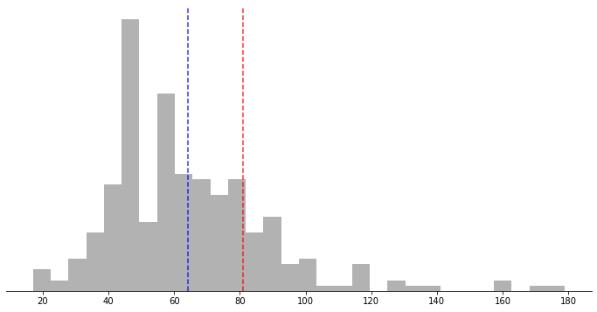
Currently We set our ticket prices to be slightly above the market average.
Ticket price distributions for resorts in market share
Big Mountain
Average
Adult weekend ticket price ($)

Slide 3
However, we are much more than “slightly” above Average
Skiable terrain area: 98th percentile
Snow making area: 97th percentile
Longest run: 96th percentile
Number of lifts: 94th percentile
Number of fast quad lifts: 93rd percentile
Vertical drop: 90th percentile

Slide 4
How can we better leverage our top tier facilities?

